Slide 1
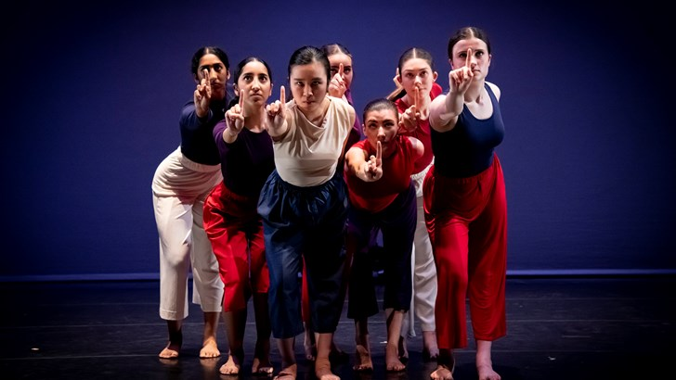
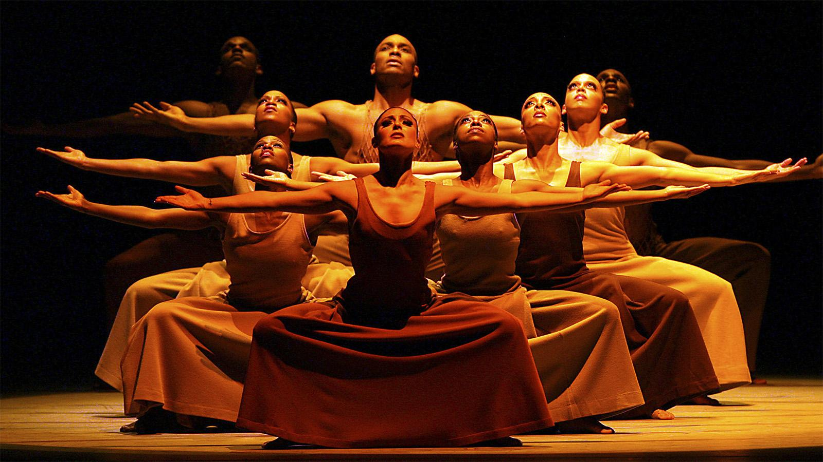
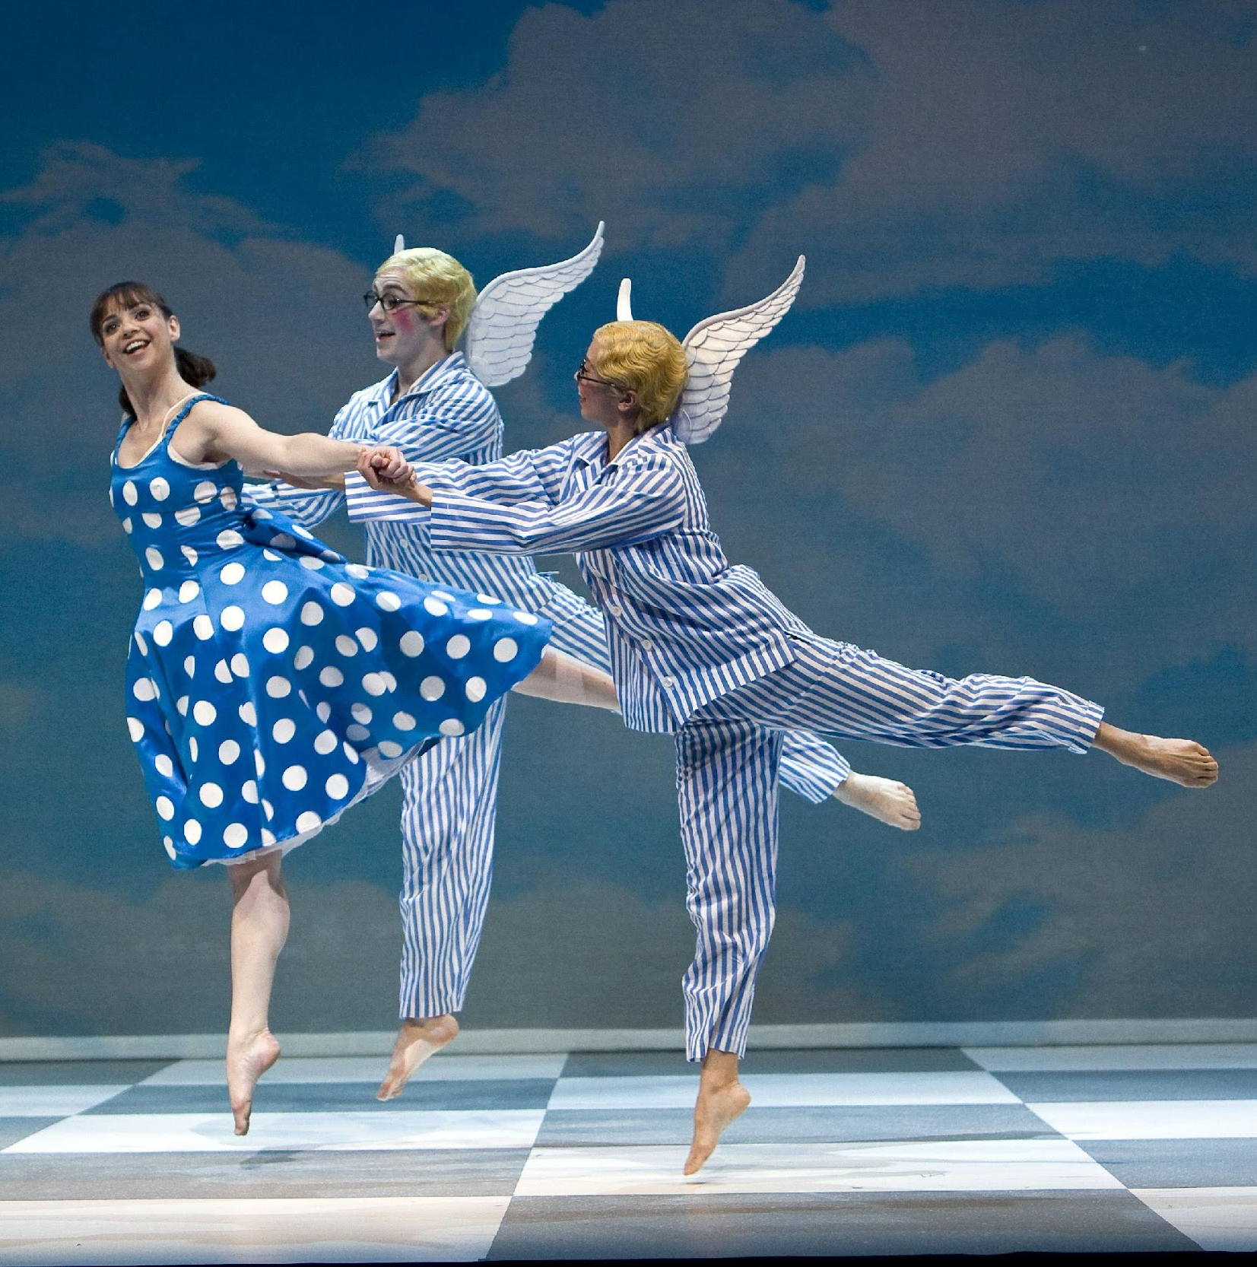
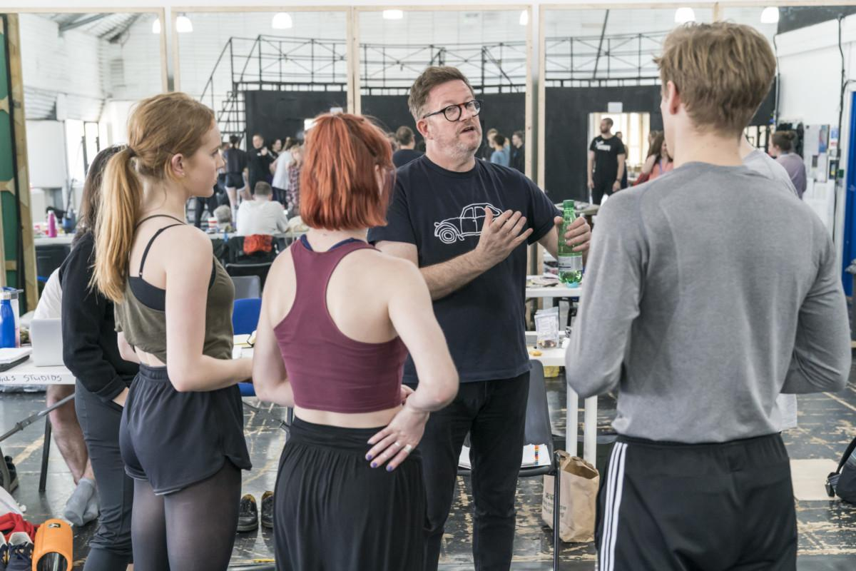
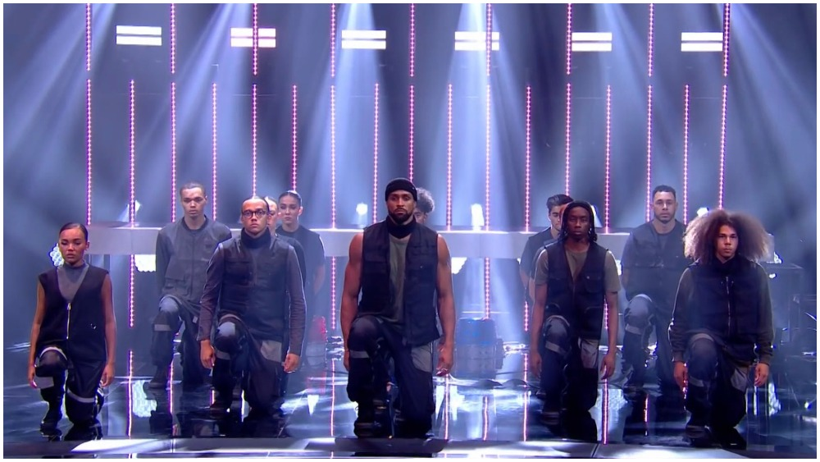
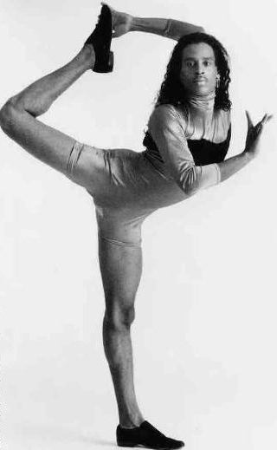
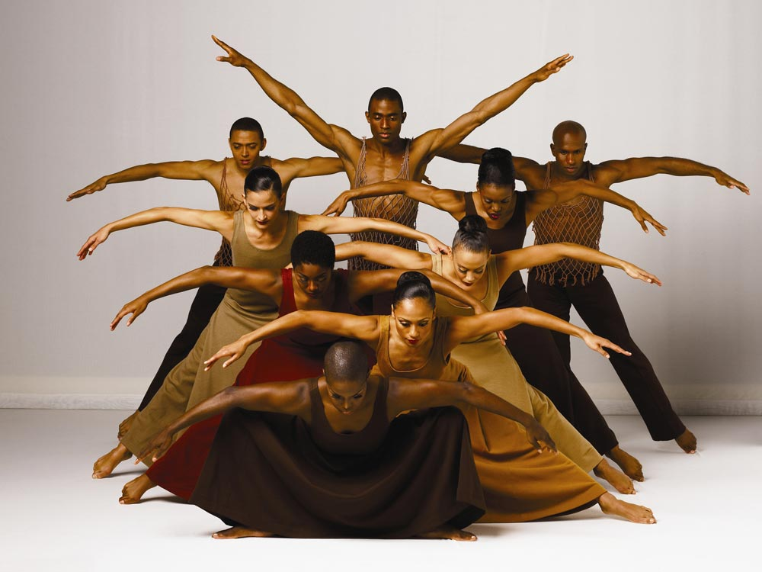
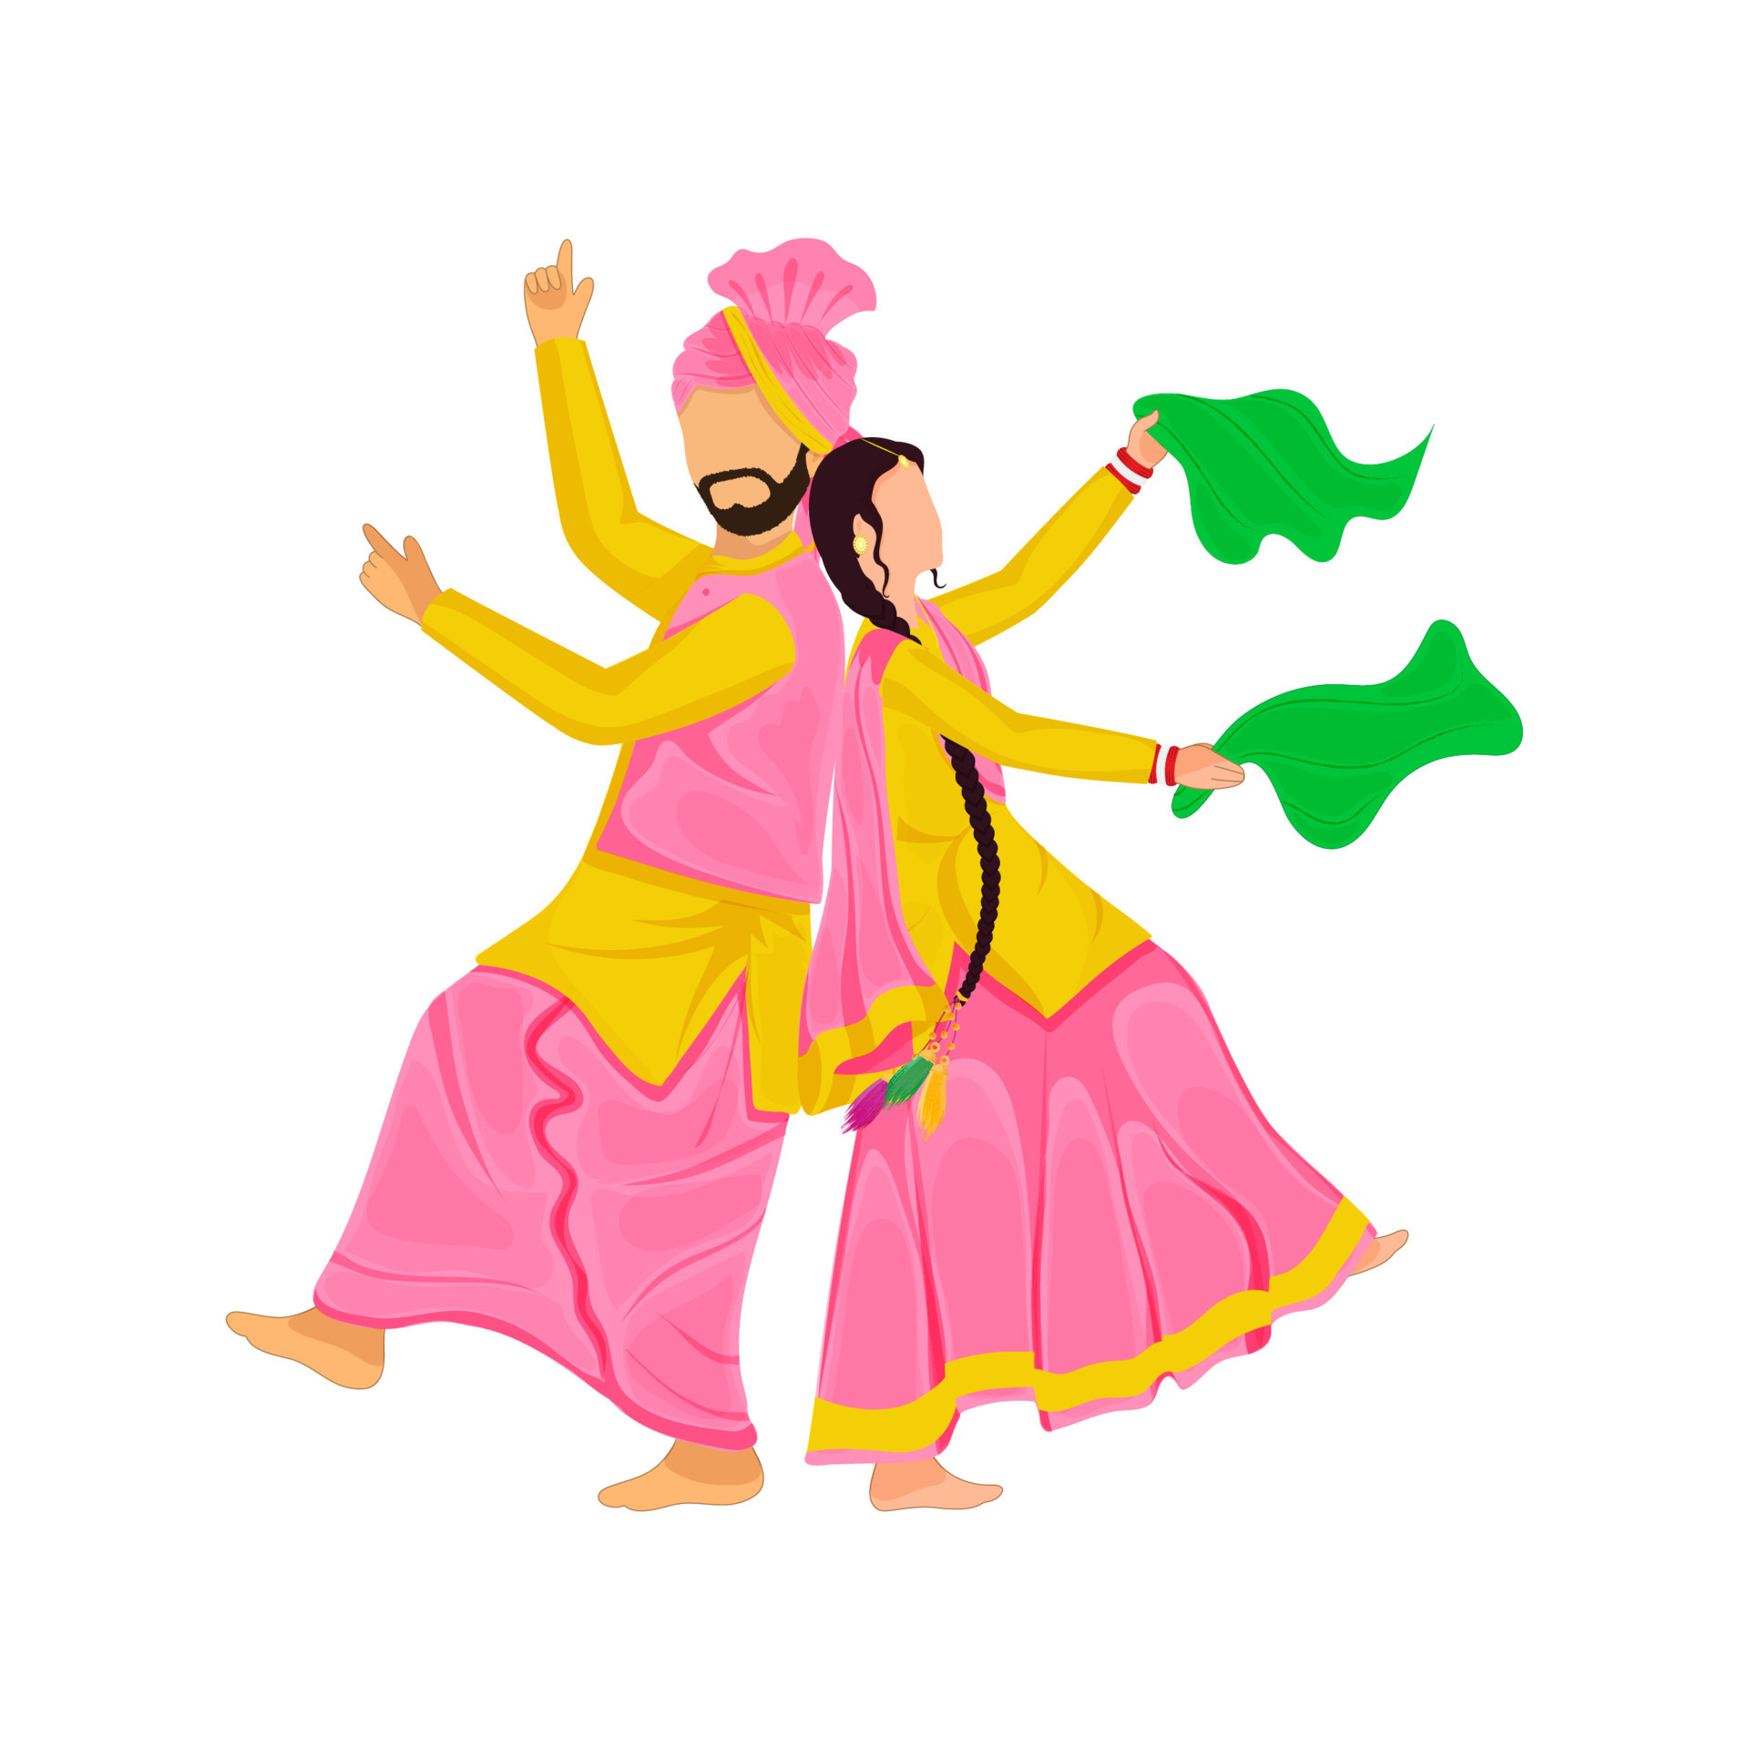
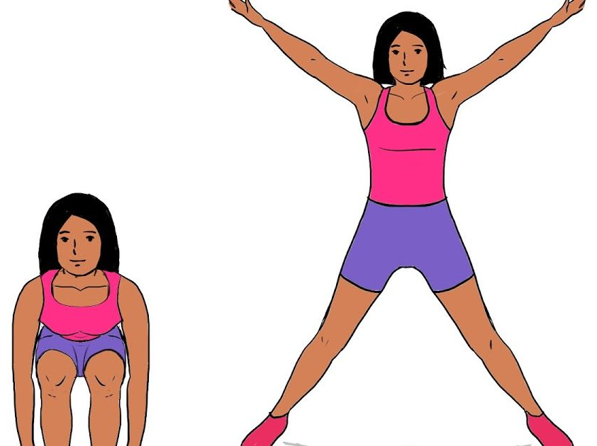
Careers/Pathways
Performer
Choreographer
Director
Dance Teacher
Dance Movement Therapist
Arts Administrator
Dance Critic
Further/Higher Education Dance Lecturer
Talent Agent
Dance Health Practitioner
Dance Scientist
Youth worker
Pilates/Yoga Instructor
Dance Learning Journey
Performance
Choreography
Appreciation
Rehearsal Etiquette
-Level 3 BTEC Dance
-College
-University
OCR GCSE PE/SPORTS STUDIES?
COMPONENT 3- Responding to a Brief.
COMPONENT 2- Developing Skills and Techniques in the Performing Arts.
Working as part of a group to choreograph a workshop performance in response to a brief.
Developing performance skills through the reproduction of professional repertoire.
YEAR
11
Level 2 BTEC
Dance
Exploration/ preparatory work for the course.
COMPONENT 1- Exploring the Performing Arts.
Dance technique classes, choreography sessions, watching and analysing professional work.
Examining the work of performing arts professionals and the processes used to create performance.
YEAR
10
9.3 Are you trapped by the brief?
9.2 Is dancing just about dance?
9.1 Can dance send a message?
Working collaboratively to respond to a brief.
Can this be done effectively and creatively?
Understanding the industry roles and processes that go into creating a dance music video.
Exploration of “Black Lives Matter” Diversity.
Choreographing and learning repertoire.
YEAR
9
8.2 Are some performance skills more important than others for a dancer?
8.1 Has street dance forgotten its roots?
COACHING & LEADERSHIP
8.3 Can choreography act as a time machine?
Exploration of:
Hip-Hop, Breaking, Voguing, Waacking
Whilst developing knowledge on the history and culture of each style.
Exploration of:
Jazz dance Contemporary dance
A focus on physical, technical, and expressive skills.
Creating work based on the:
Past, present, future
YEAR
8
YEAR
7.3 Can dance influence our emotions?
CORE SKILLS/CONCEPTS
7
7.2 Does history and culture influence dance?
7.1 What is Dance?
Exploration of musicals such as:
Exploration of styles from around the world:
African, Bhangra, The Haka, Capoeira
Exploration of ASDR:
Actions, Space, Dynamics, Relationships
KS2 link:
Build on fundamental movement and communication skills learnt from primary school.

